Slide 1

11 DTE
Digital Technologies
Course Outline 2024

Slide 2
Course Topics...

Slide 3
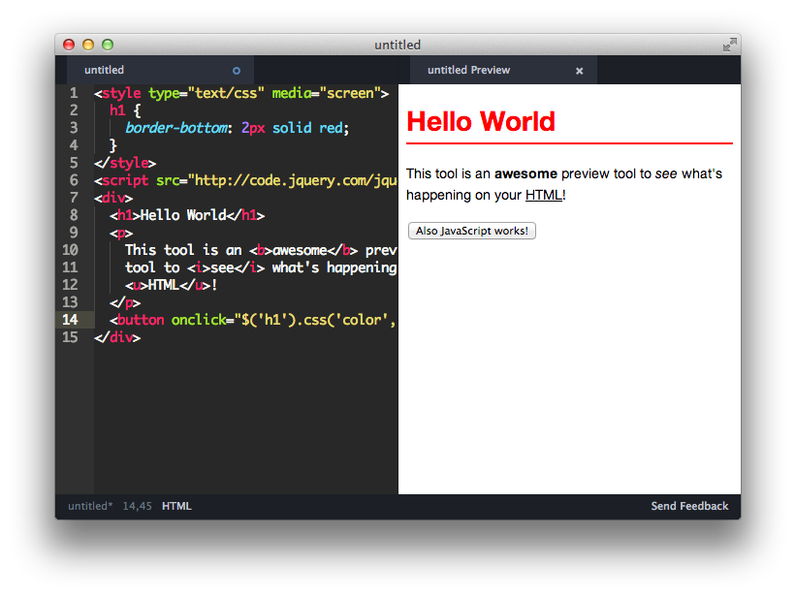
1. Web Design & Coding AS92005

Slide 4

2. Python AS92004

Slide 5
External

Slide 6

1. HCI AS92006

Slide 7
To Pass…
(e.g. to enter the DGT2 course)
14+ credits
(so you can mess up one assessment!)

Slide 8
Endorsement...
14+ credits at M/E
Including 3 from external
(so you need to do well in almost every assessment!)

Slide 9
Course Format...

Slide 10
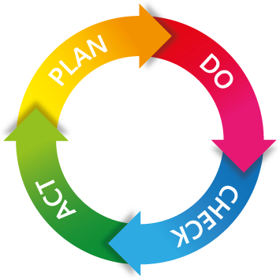
Learn by Doing
Teacher feedback…
Verbal or written
Take note
Act upon advice
Notes:
Trying and succeeding / failing is the best way to learn

Slide 11

Ok to Learn Together
Notes:
During learning, working in a PAIR (no more) is encouraged

Slide 12

Assessment 100% Your Own
Notes:
For the assessment… only OWN work will be accepted

Slide 13
Assessment...

Slide 14

Deadlines
Deadlines are fixed
No extensions
No late work accepted
(Unless exceptional circumstances and/or pre-arranged with HoD)

Slide 15
Authenticity
Work must be your original creation
If other's work is used with permission, source must be cited
Plagiarised work will be awarded 'NA'
(if you copy from, or are helped by, another student, they too are at risk of receiving 'Not Achieved')

Slide 16

Handing In
Must hand in directly to your teacher:
Electronically (e.g. via Classroom)
Not via another student / teacher / office

Slide 17
Resubmissions
A chance to tweak your work
May be offered by your teacher, but...
Only if work is close to meeting a grade
Hints given, but up to you to fix issues
(You will not automatically get a chance to resubmit)

Slide 18

Security of Work
Store work on school servers (get backed-up regularly)
Work outside of school is your own responsibility to back-up
'Backed-up' means two or more copies!
(Lost work, e.g. USB stick failure, is not an excuse for late / missing assessment)

